Slide 1
Fields and Waves I
Exam 2 Review
James D. Rees
Electrical, Computer, and Systems Engineering Department
Rensselaer Polytechnic Institute, Troy, NY
Notes:
Welcome to Fields and Waves I
Before I start, can those of you with pagers and cell phones please turn them off? Thanks.

Slide 2
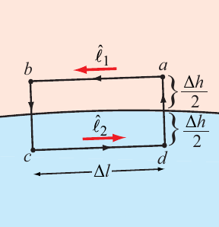

Boundary Conditions
So component of the E-field that is tangent to a media boundary is continuous across it.
What about normal to the boundary?
Ulaby

Slide 3
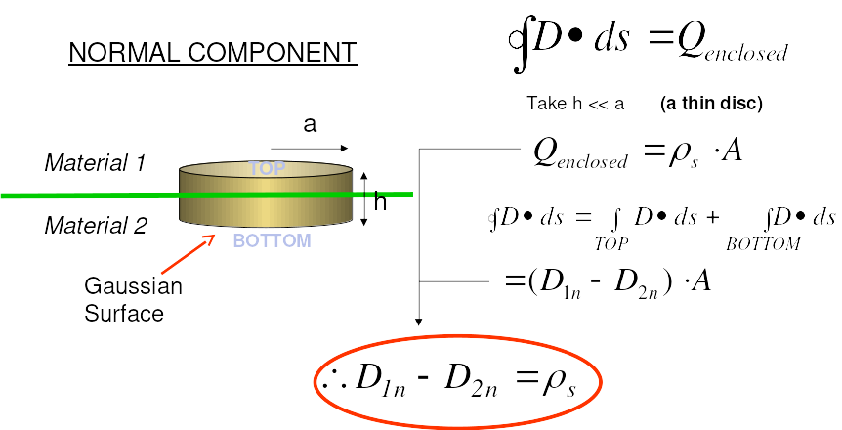
Boundary Conditions

Slide 4
Dielectrics + Boundary Conditions
1.) An electric field of 4 V/m strikes a dielectric of relative permittivity 10 at an angle of 45 degrees. Determine the magnitude of the E-field inside the material as well as its angle relative to the boundary.
2.) Replace the dielectric with a conducting material. What is its surface charge density where the electric field touches it?

Slide 5
Dielectrics + Boundary Conditions

Slide 6
Dielectrics + Boundary Conditions

Slide 7
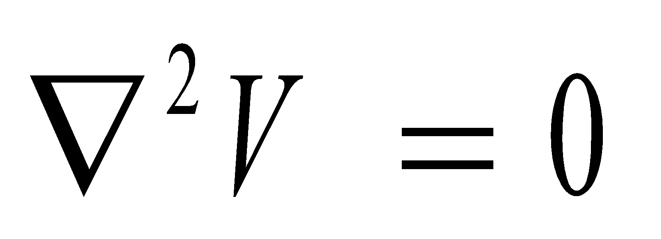
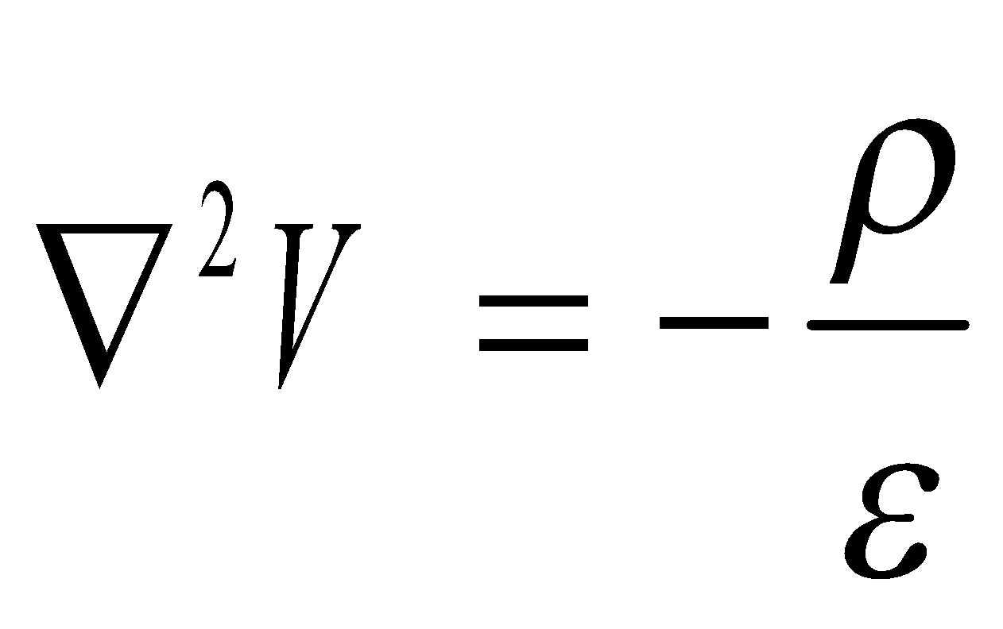
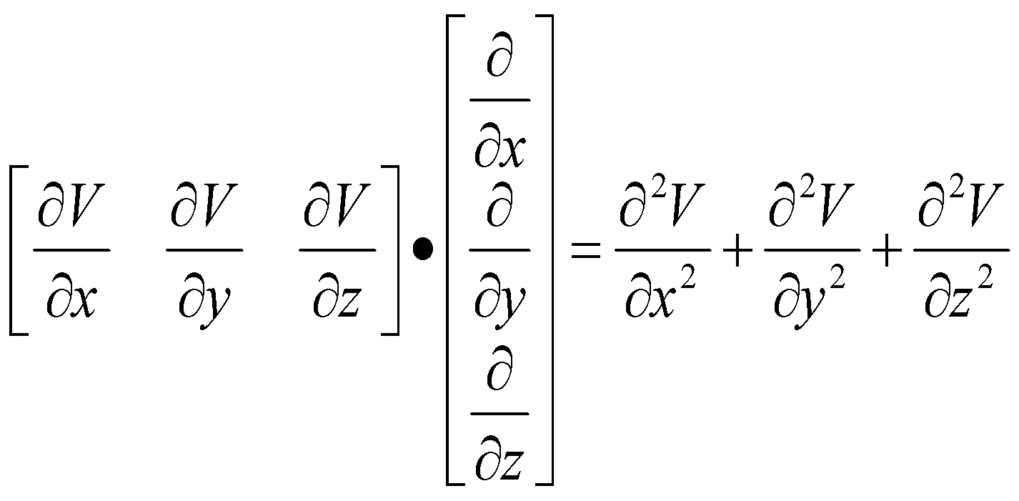

Laplace and Poisson Equations
Laplace’s Equation:
Poisson’s Equation
(in cartesian coordinates)

Slide 8
Laplace and Poisson Equations
A dielectric sphere with 10cm radius, relative permittivity 5, and a bound charge of 1 C/m3 is grounded at its center. Use Laplace and Poisson’s Equations to find the voltage at all r.

Slide 9
Laplace and Poisson Equations

Slide 10
Laplace and Poisson Equations

Slide 11
Smith Charts
1.) Suppose the input impedance of a 0.2 wavelength transmission line is 4 ohms. Find the load impedance.
2.) You have a length of transmission line with a load at the end. Its input admittance is 1+0.7j. You wish to match it to the line’s characteristic impedance. What length of open-circuit stub should be added in parallel at this point to match the line?

Slide 12
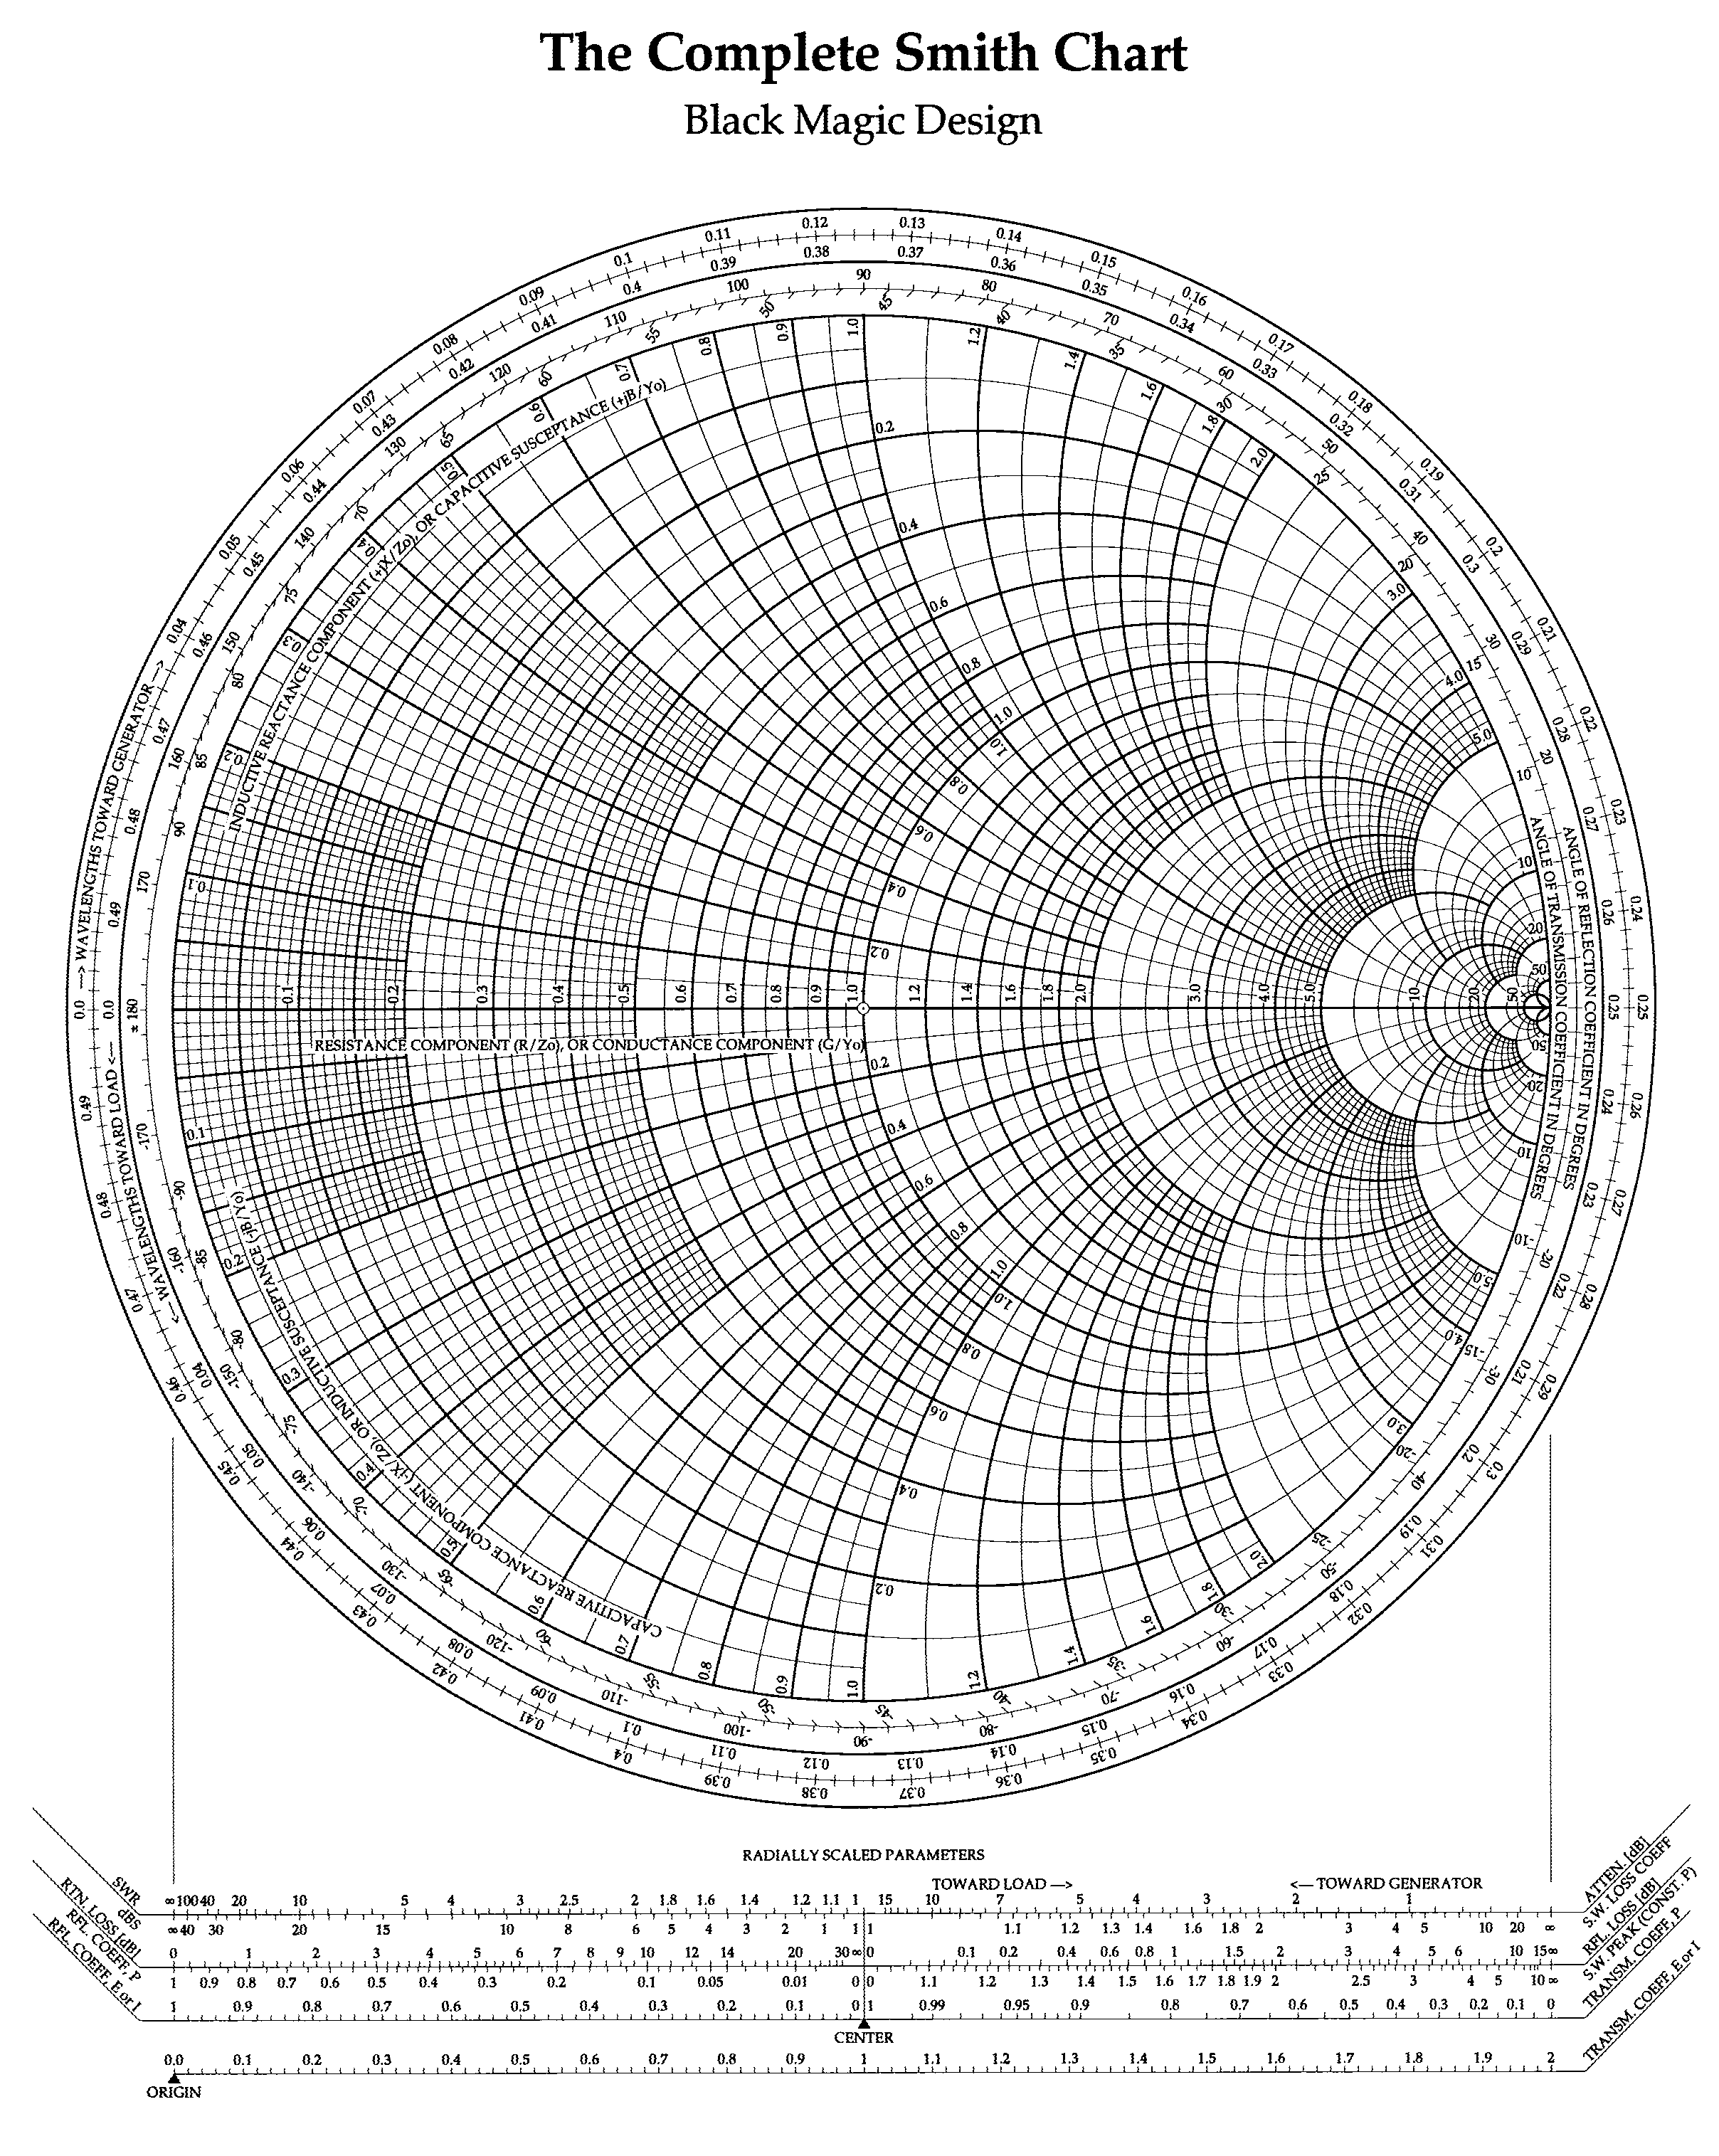
Smith Charts

Slide 13
Smith Charts

Slide 14
Field Math
Differential Surfaces and Volumes
How do you describe the shapes of all the ds surfaces in the following coordinate systems?
Cartesian coordinates:
https://mathinsight.org/cartesian_coordinates
Cylindrical coordinates:
https://mathinsight.org/cylindrical_coordinates
Spherical coordinates:
https://mathinsight.org/spherical_coordinates

